Slide 1
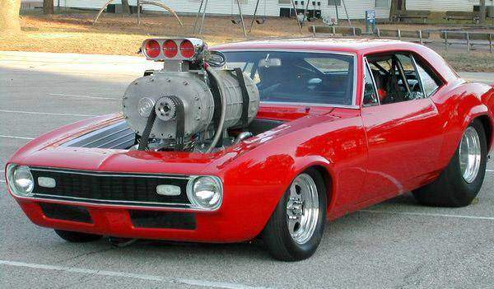
Supercharge your Intune Setup

Slide 2




Kim Oppalfens
Tom degreef
CIO, OSCC
Extraordindary Consultant, OSCC
Kim.oppalfens@oscc.be
@thewmiguy
@tomdegreef
1-2-3; 2-3; 1-3; 2-3

Slide 3
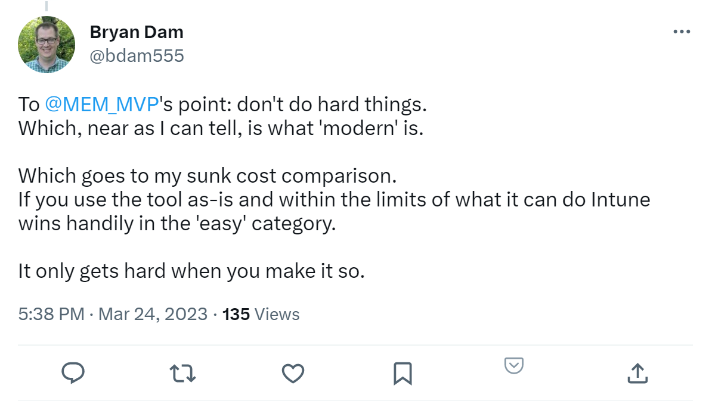

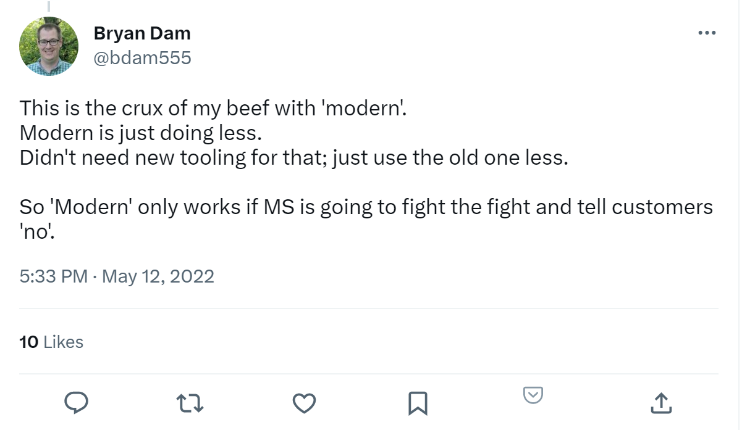
Setting expectations
We did most of the heavy lifting
This is meant to work for Native Azure AD clients
K

Slide 4
Welcome
ADDS
Single-Server setup
Manual configuration tasks
Protecting (RDP) access to the Server
Cost
T

Slide 5
ADDS
K
Notes:
Create A Dedicated Account To Join Computers To A Domain | Richard Skinner (richardstk.com)

Slide 6
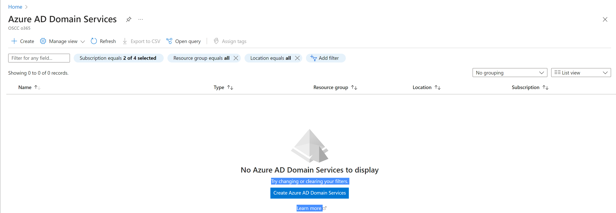
ADDS
K

Slide 7
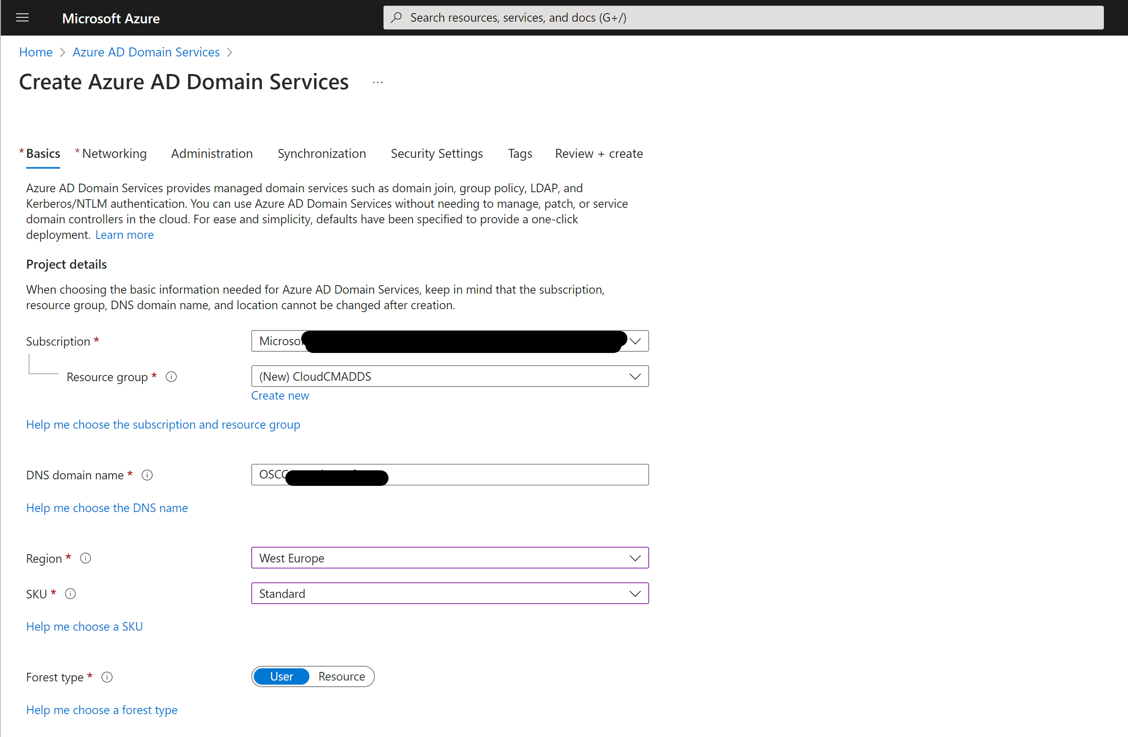
ADDS
K

Slide 8
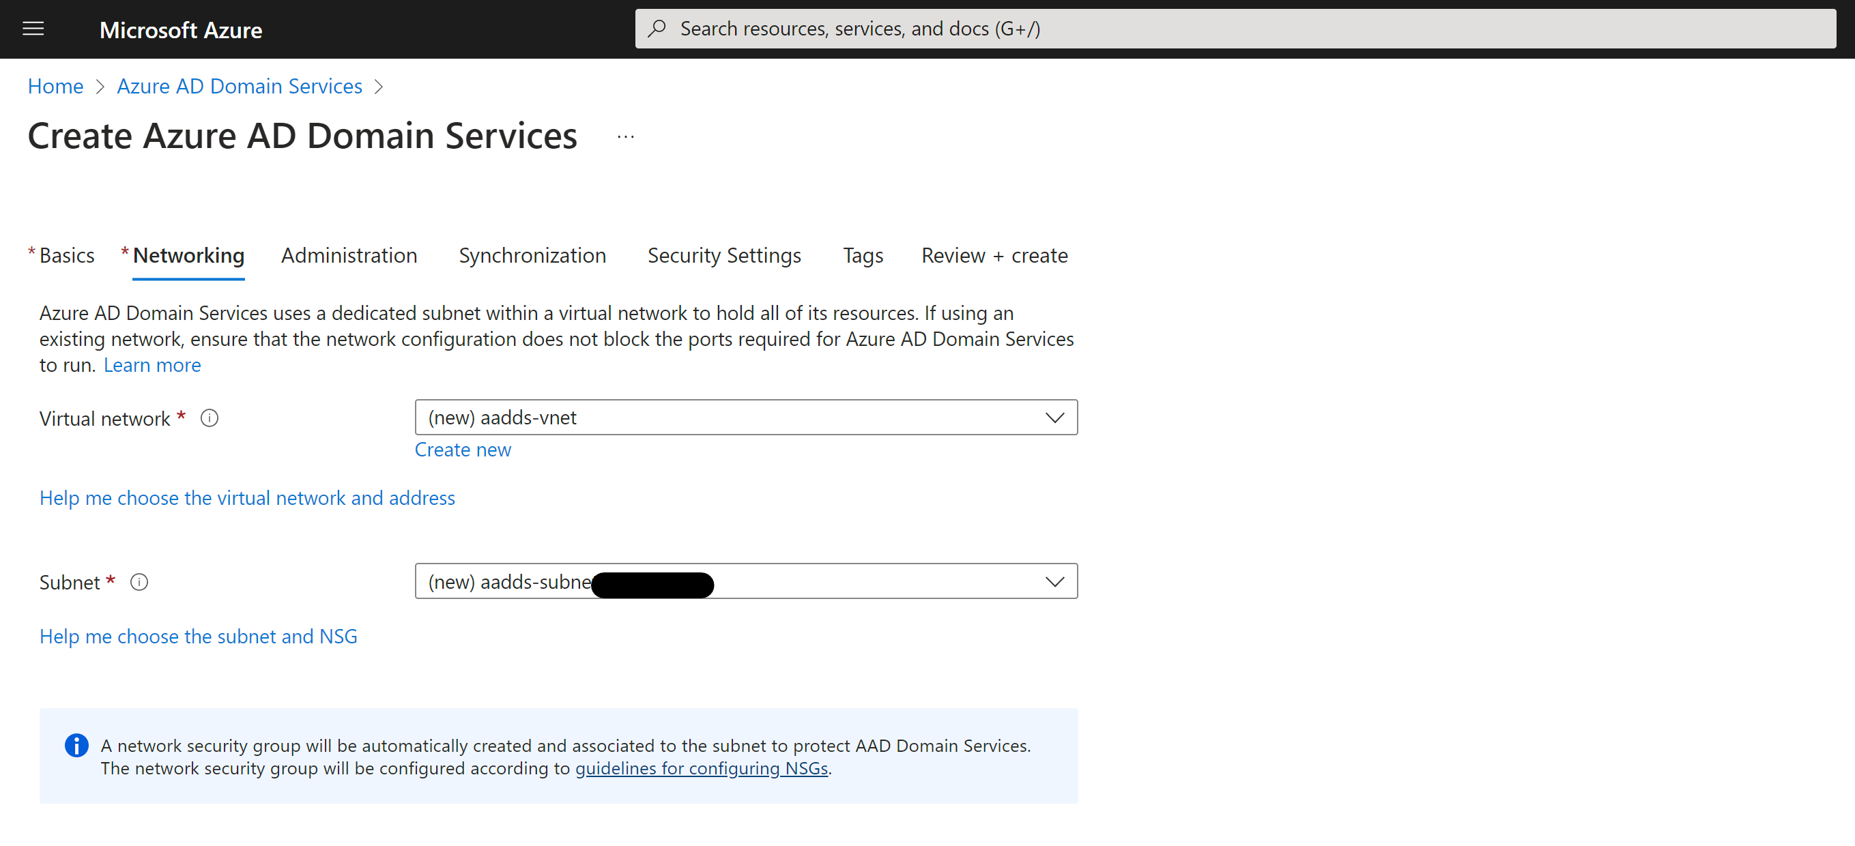
ADDS
K

Slide 9
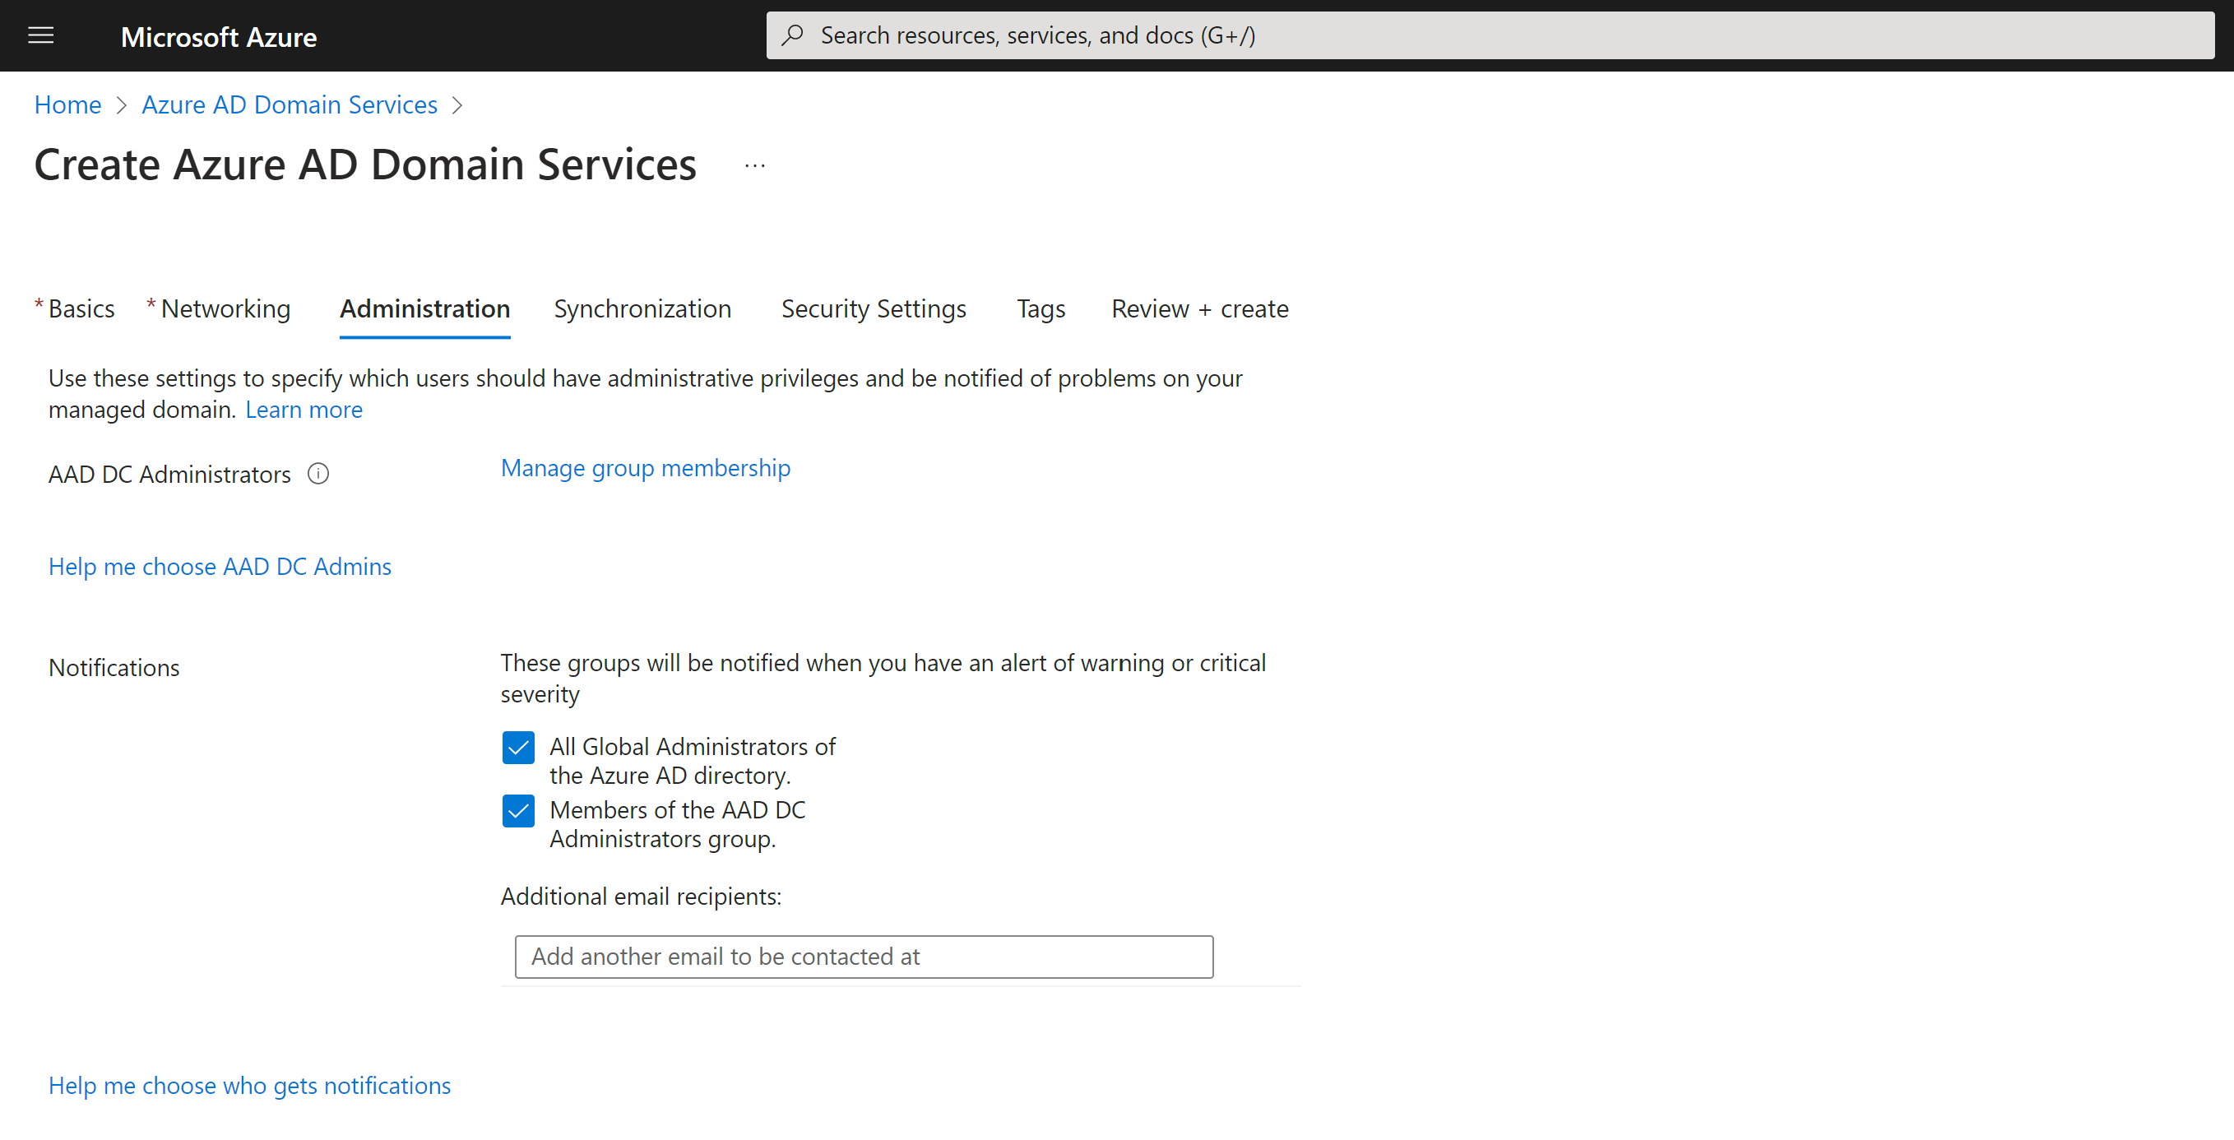
ADDS
K

Slide 10
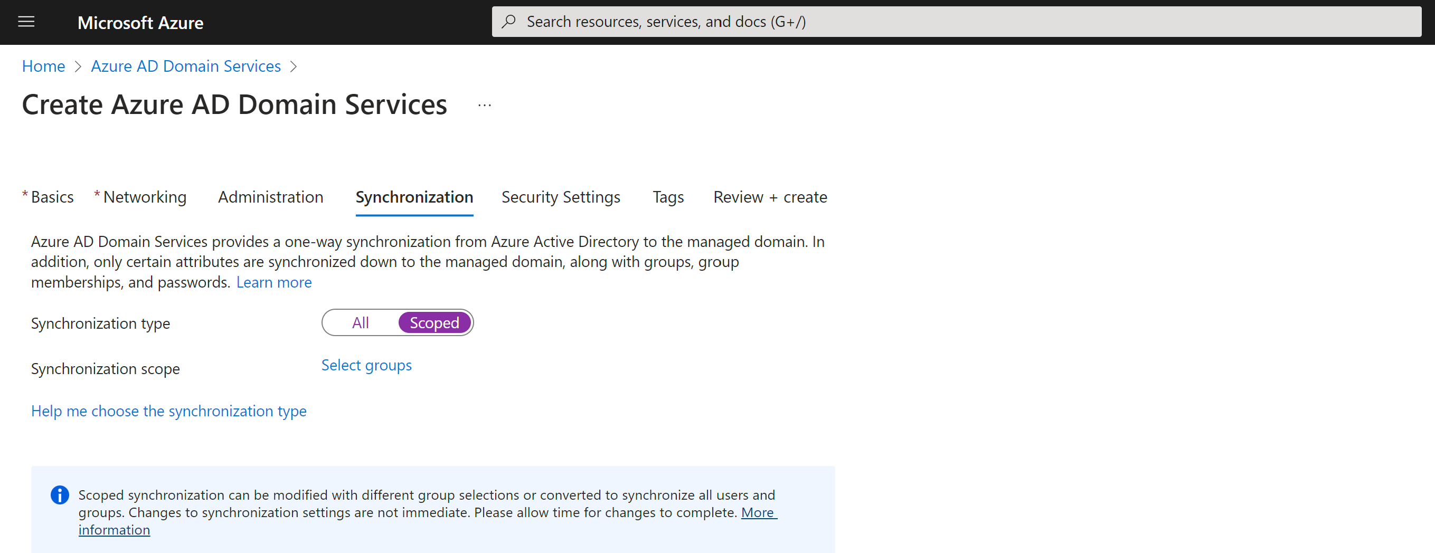
ADDS

Slide 11
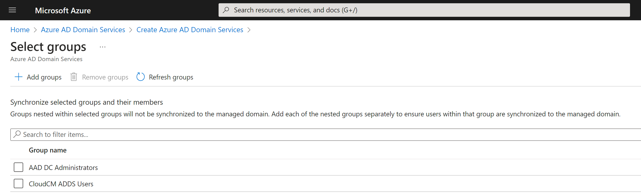
ADDS
K

Slide 12
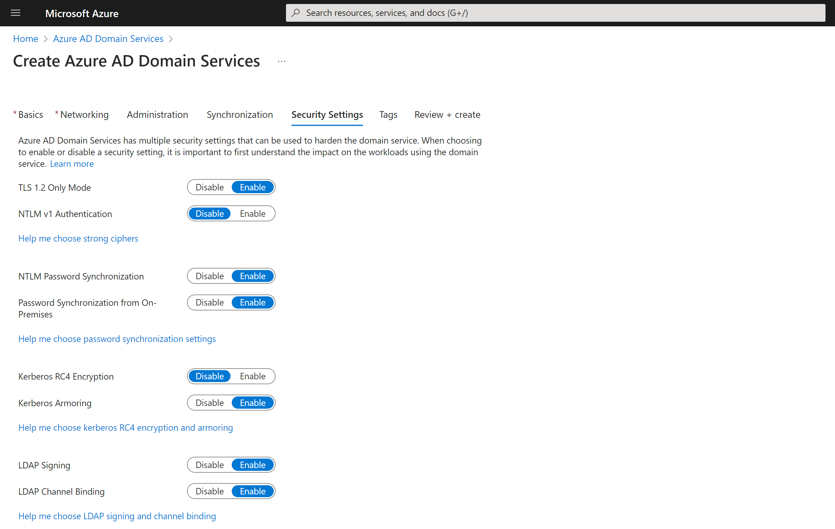
ADDS

Slide 13
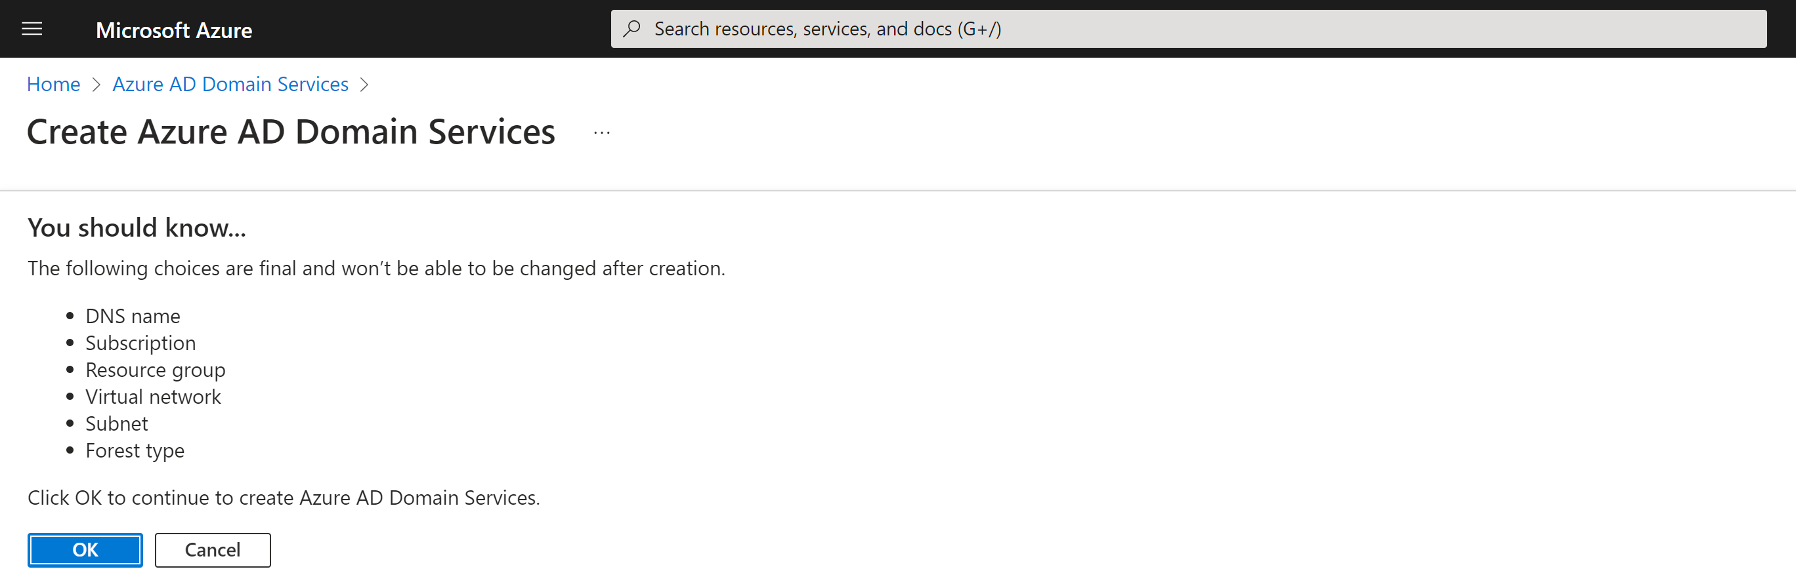
ADDS
K

Slide 14
Single-Server Configmgr Setup
Join the domain
Run Configure-SCCM.PS1 (zero touch)
Downloads all required files
Configures Windows Prerequisites
Installs SQL Server 2022
Installs latest Configmgr baseline build (2203)
Upgrades to latest public Configmgr build (2211)
We need this for some Cmdlets
Setup will be even easier when 2303 becomes a baseline
T

Slide 15
Create Configmgr Server
T

Slide 16
Setup the Cloud management Gateway
Run Configure-CMG.ps1
Provide Subscription ID
Provide Azure Resource group
Creates self signed root & Server Certificate
Configures Azure Services
Configures CMG
Configures Boundaries, Client settings, …
K

Slide 17
Enable the CMG
T

Slide 18
What’s left for you to do …
Distribute Root Certificate
Or replace the Certificate in the CMG with a public Cert
Configure Co-Management
Add Intune Admins to Configmgr
T

Slide 19
Enable Co-Management
Just 4 clicks!
T

Slide 20
Protecting (RDP) access to the server with JIT
K
Notes:
Multilayered protection for Azure virtual machines - Azure Solution Ideas | Microsoft Learn

Slide 21
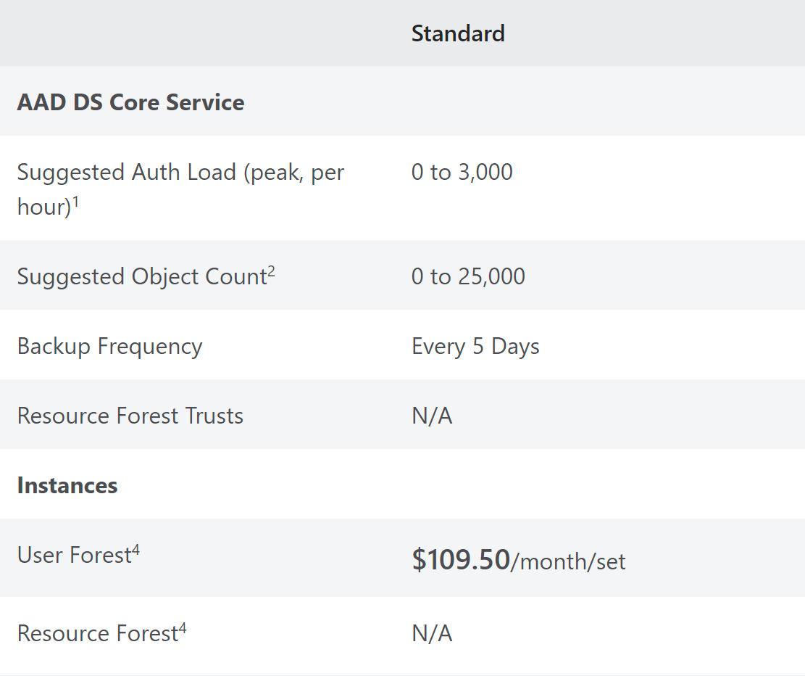
Cost / Month
110$
1 ADDS Standard SKU =>
1 VM =
Standard D2s v3 (2 vcpus, 8 GiB memory)
1 CMG =>
Standard_A2_V2 (1 instance)
1 Public Certificate (Optional) =>
Bandwidth out =>
2.5 Terrabyte (1 Gb/ 2.500 clients/ month)
Total for 2.500 clients, 735$ or 25 cent / client / month
150$
150$
25$
200$
K

Slide 22

What’s left for us/community to do?
Create ARM template
Join Domain
Start Install
Copy CMG Setup script
Automate Cloud Attach?
Optional: Configure ConfigMgr Auto-Upgrade
Pre-Create groups to grant permissions in ConfigMgr
Pre-Create practical collections & Sync them up
Pre-Create practical Scripts?
Create Blog series / Documentation
@thewmiguy
@tomdegreef
#SuperchargeIntune

Slide 23
T

Slide 24
@thewmiguy
@tomdegreef
#SuperchargeIntune
K

